Slide 1
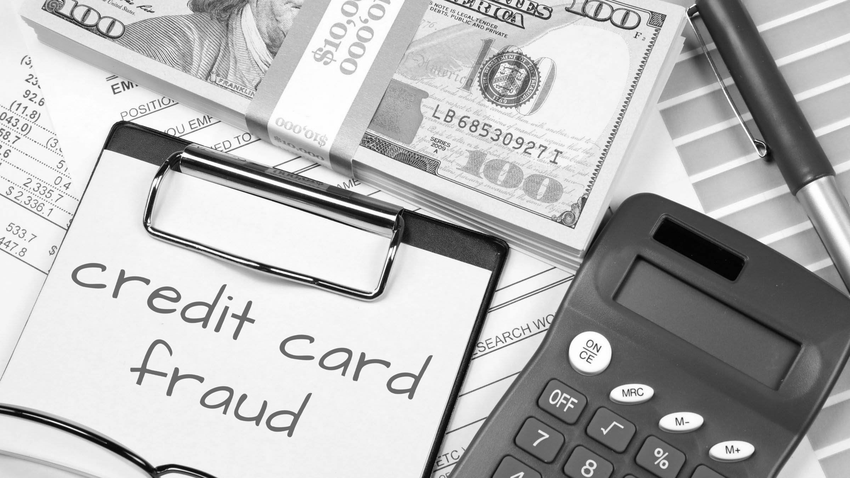
Credit Card Fraud Trends and Predictions
Team 1 Authors:
Ashleigh Bridges, Sean Flinn, Sha’Irene Reid, Rebecca Allison , Mike Bowman

Slide 2
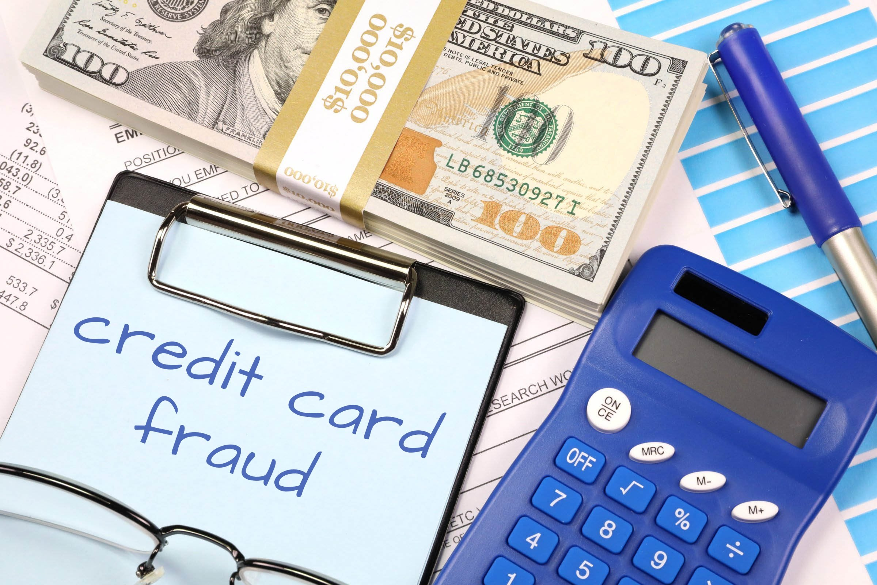
Why did we select Credit Card Fraud as the topic for this project?
We chose this topic due to our team’s background in the financial service sector and two teammates with credit card experience.

Slide 3
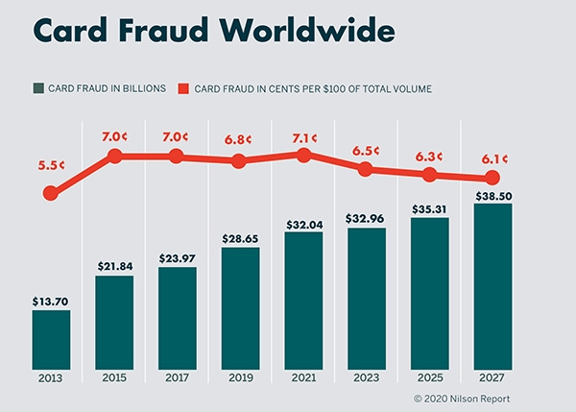
Understanding Credit Card Fraud
Credit card fraud is a global problem and the cost of fraud is rising each year
Financial impacts of fraud can be significant and have downstream impacts
Banks are investing significant time and money in machine learning to help detect and mitigate fraud as quickly as possible
Notes:
According to one study, $1 of fraud now costs businesses $3.75 (LexisNexis)

Slide 4
What is Credit Card Fraud?
Credit card fraud can occur when unauthorized users gain access to an individual’s credit card information in order to make purchases, other transactions, or open new accounts.
Forms:
Lost or stolen cards
Not Received as Issued (Never Received) – Account Takeover
False Application /New Account fraud
Counterfeit / Skimming
Card Not Present fraud (online / phone / mail)
Notes:
According to a 2021 report , about 50% of all Americans have experienced a fraudulent charge on their credit or debit cards, and more than one in three credit or debit card holders have experienced fraud multiple times. This amounts to 127 million people in the US that have been victims of credit card theft at least once.

Slide 5

Source of Data
Our Dataset is a simulated credit card transaction dataset, covering the cards of 1000 customers with a pool of 800 merchants.
Data set covers transactions over a full two-year period.
Contains both legitimate and fraudulent transactions.
Link to dataset: https://www.kaggle.com/datasets/kartik2112/fraud-detection

Slide 6

Questions to be Answered
Are there any trends in the data?
Can any of these trends be used to predict and prevent future fraudulent transactions?
Focus of our Study
Merchants: Which merchants have the most fraud cases?
City/State/Region: Is there are a primary area where fraud occurs?
Age of purchaser: What is the age of purchaser impacted by fraud?
Fraud amounts: What fraud amounts are being incurred?
Transaction Types: What types of transactions are involved with fraud cases?

Slide 7
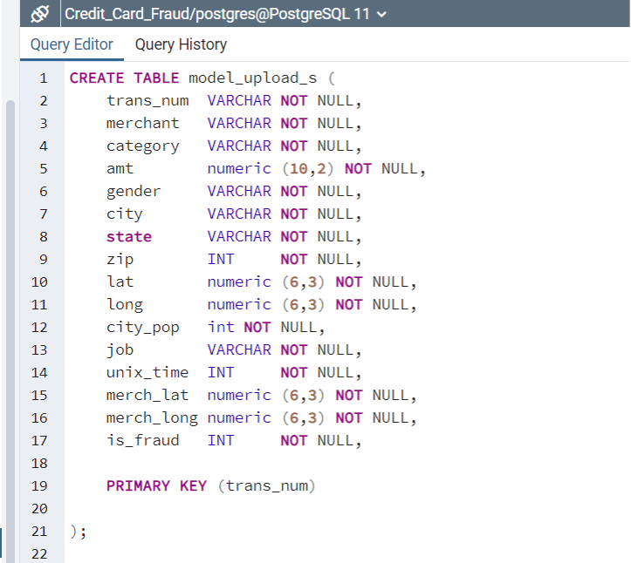
Data Exploration Phase
Kaggle data was inspected, cleaned, analyzed, and separated into two tables:
Model Upload Data: Data used with Machine Learning Models

Slide 8
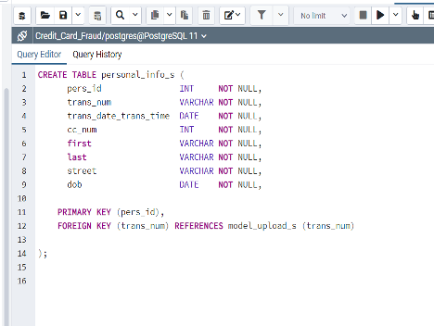
Data Exploration Phase (cont’d)
Second table created - Personal Information Data
Data that is typically seen as “PI” in most financial institutions

Slide 9
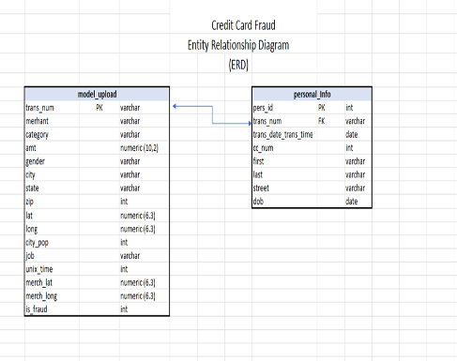
Creation of Entity Relationship Diagram
Data was tested by means of joining tables and performing counts of the relevant remaining data.
The Model Upload table data was then uploaded into Amazon Web Services in a S3 bucket for the machine learning analyzation portion of the project

Slide 10
Analysis Phase
The purpose of the analysis was to predict if a transaction is one of two values: Fraudulent or Non-Fraudulent
Logistic Regression model was initial focus due to this binary outcome
Models tested included SMOTE, Random Undersampling, Random Oversampling, and Random Forest

Slide 11
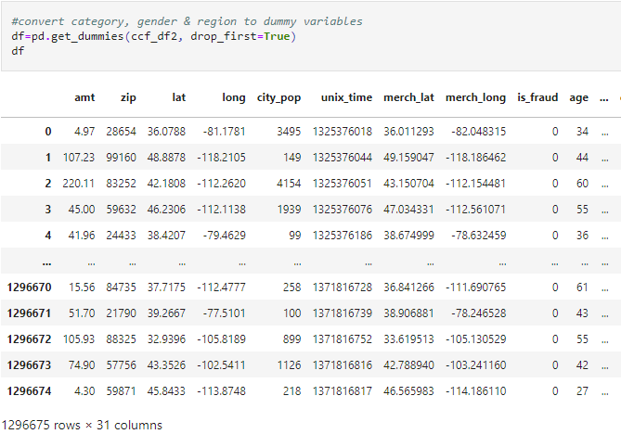
Machine Learning
Preprocessing
23 Columns of Data
Target
Categorical Values
Combined Column and DOB
Trans_Date_Trans_Time
DOB
State
Bucket to Regions
Encode remaining categorical data
SCALE
Train Test Split
Notes:
23 columns of data with over a Million rows of data. Initially this is a LOT but hey more for the machine to learn and consider.
As we are attempting to predict fraud we are targeting the Is Fraud column which is a simple 0 - for not fraud and 1 for fraud.
Next we need to take a look at our categorical columns
11 columns where 8 of them have a minimum of 350+ unique values
Bucketing will overfit and many are not true value add (name, street, city, etc)
Trans column was combine of values that could provide more value. Create code in order to split this out and make them integer values
DOB was a categorical, so changed this to integer values
States was 51 categorical, bucket to Regions to simplify the code
Kept all integer values and reduced categorical to gender, and trans category
Forgot to Scale initially and had very different results. Found in an iteration and updated the code Results were on the other slide

Slide 12
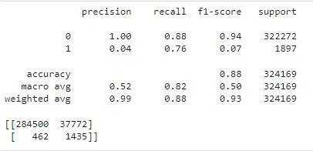
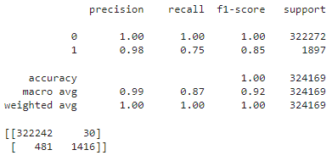
Machine Learning
Methods and Results
Logistic Regression
SMOTE vs Random Forest
Accuracy, Precision, and Sensitivity

Slide 13
Can it be Better?
Methods - SMOTE, Random UnderSampling, Random OverSampling, Random Forest
Consider Spending History
Add weight to change in spend patterns
Reduce Features - Amount, Spend History, Age, Time, Day, Month, and Region
Results
Minimal increase in identified fraud.
Significant increase in false positives.

Slide 14
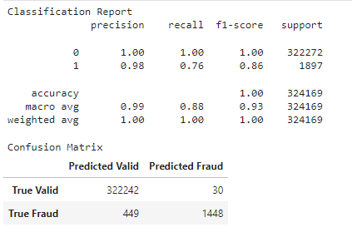
Final Solution
Method - Random Forest
Focused Features - Amt, Zip, City Population, Spend Pattern, Time, Day, Month, Category of Transaction, Gender, Region

Slide 15
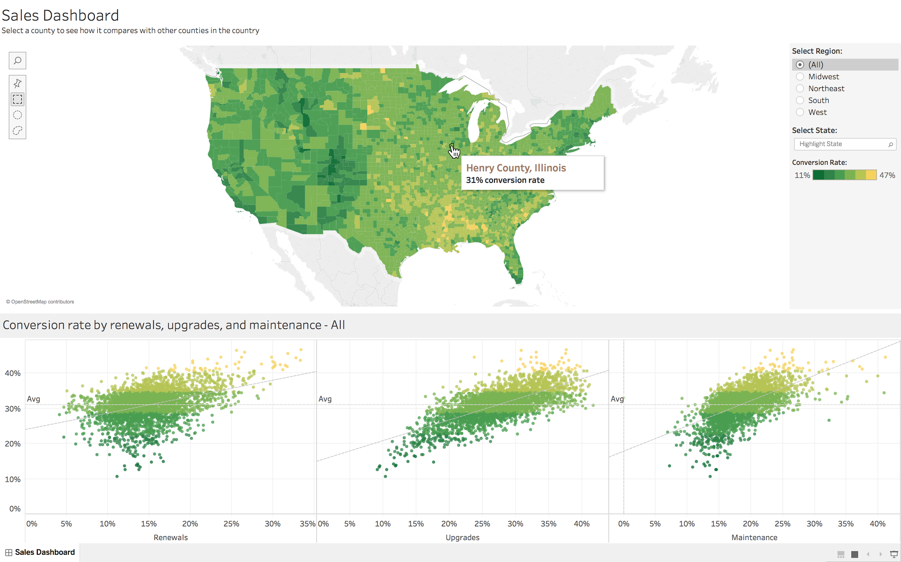
Tableau Dashboard
Tableau will be used to create final Dashboard
Use Visualization from worksheets to visualize credit card fraud
Be able to locate trends using visualization

Slide 16
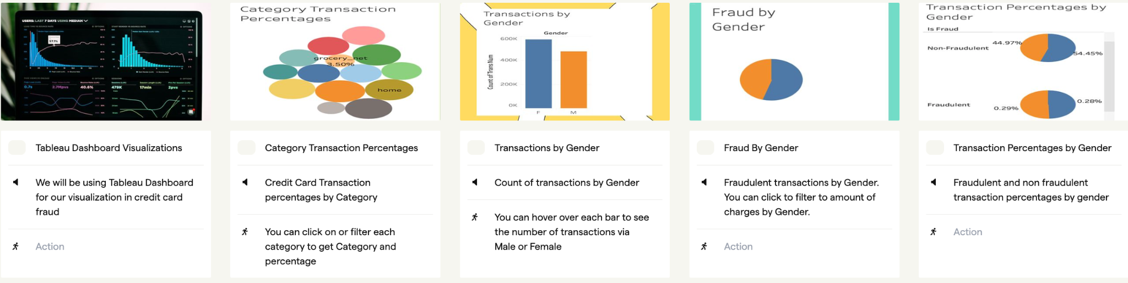
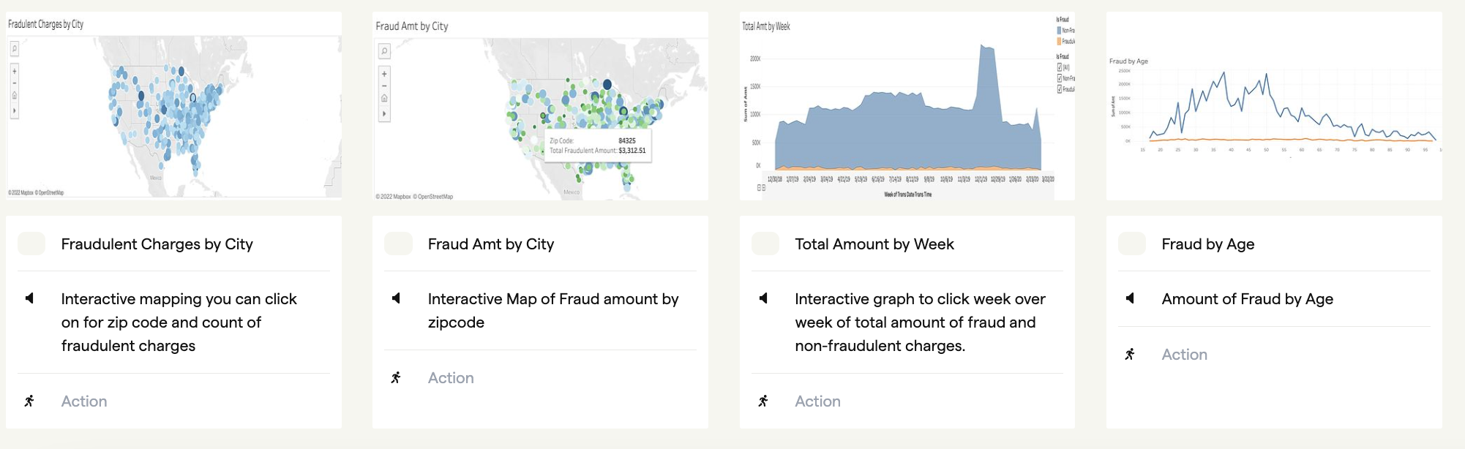
StoryBoard

Slide 17

Technologies
Languages
Tools
Algorithms
Entity Relationship Diagram
Jupyter Notebook
AWS
Python
Tableau
PostgreSQL
GitHub
SMOTE
Random Forest
Random Oversampling
Random Under Sampling

